Slide 1
Tugas 7 TPJ
Ariski Myardi 1103220019

Slide 2
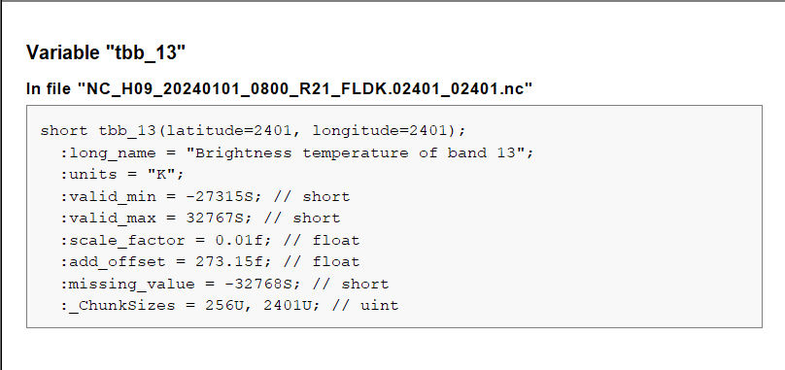
In file "NC_H09_20240101_0800_R21_FLDK.02401_02401.nc" tbb_13

Slide 3
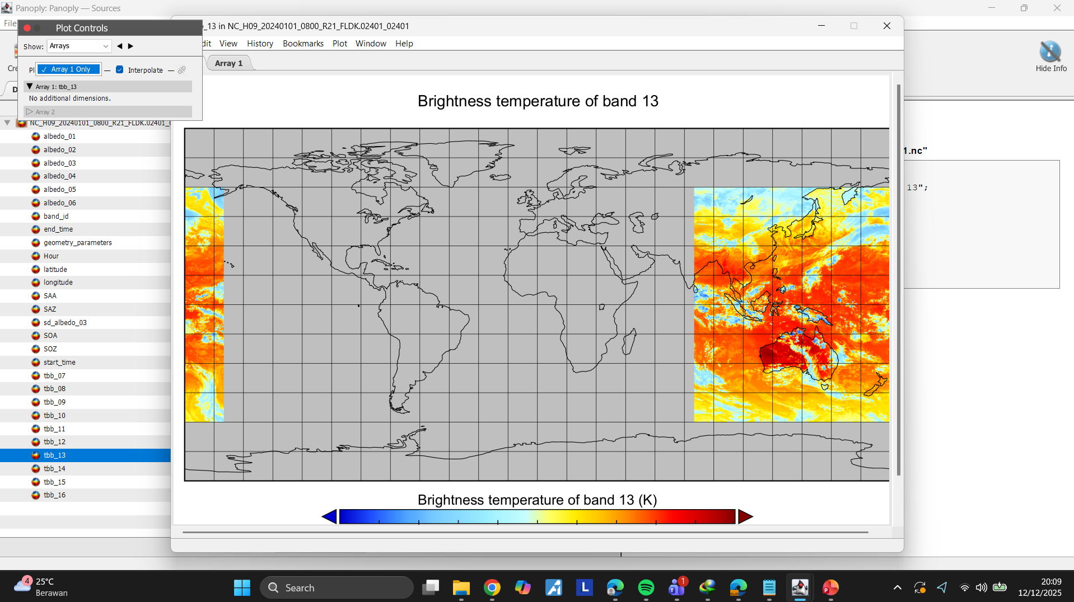
Arrays

Slide 4
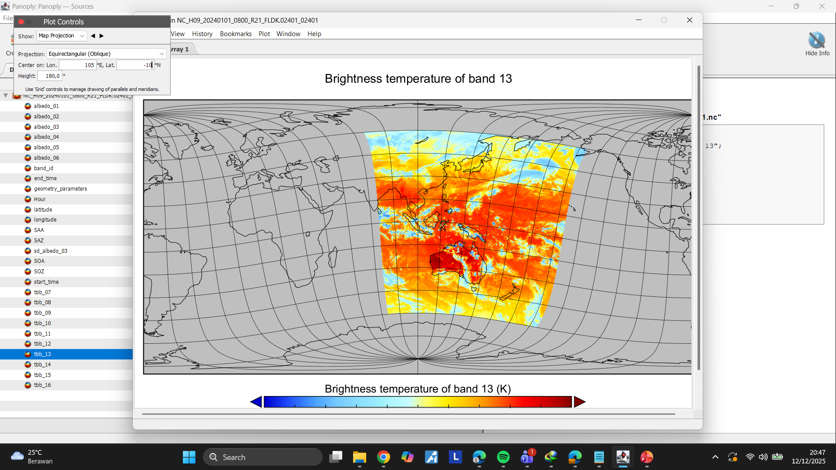
Map Projection

Slide 5
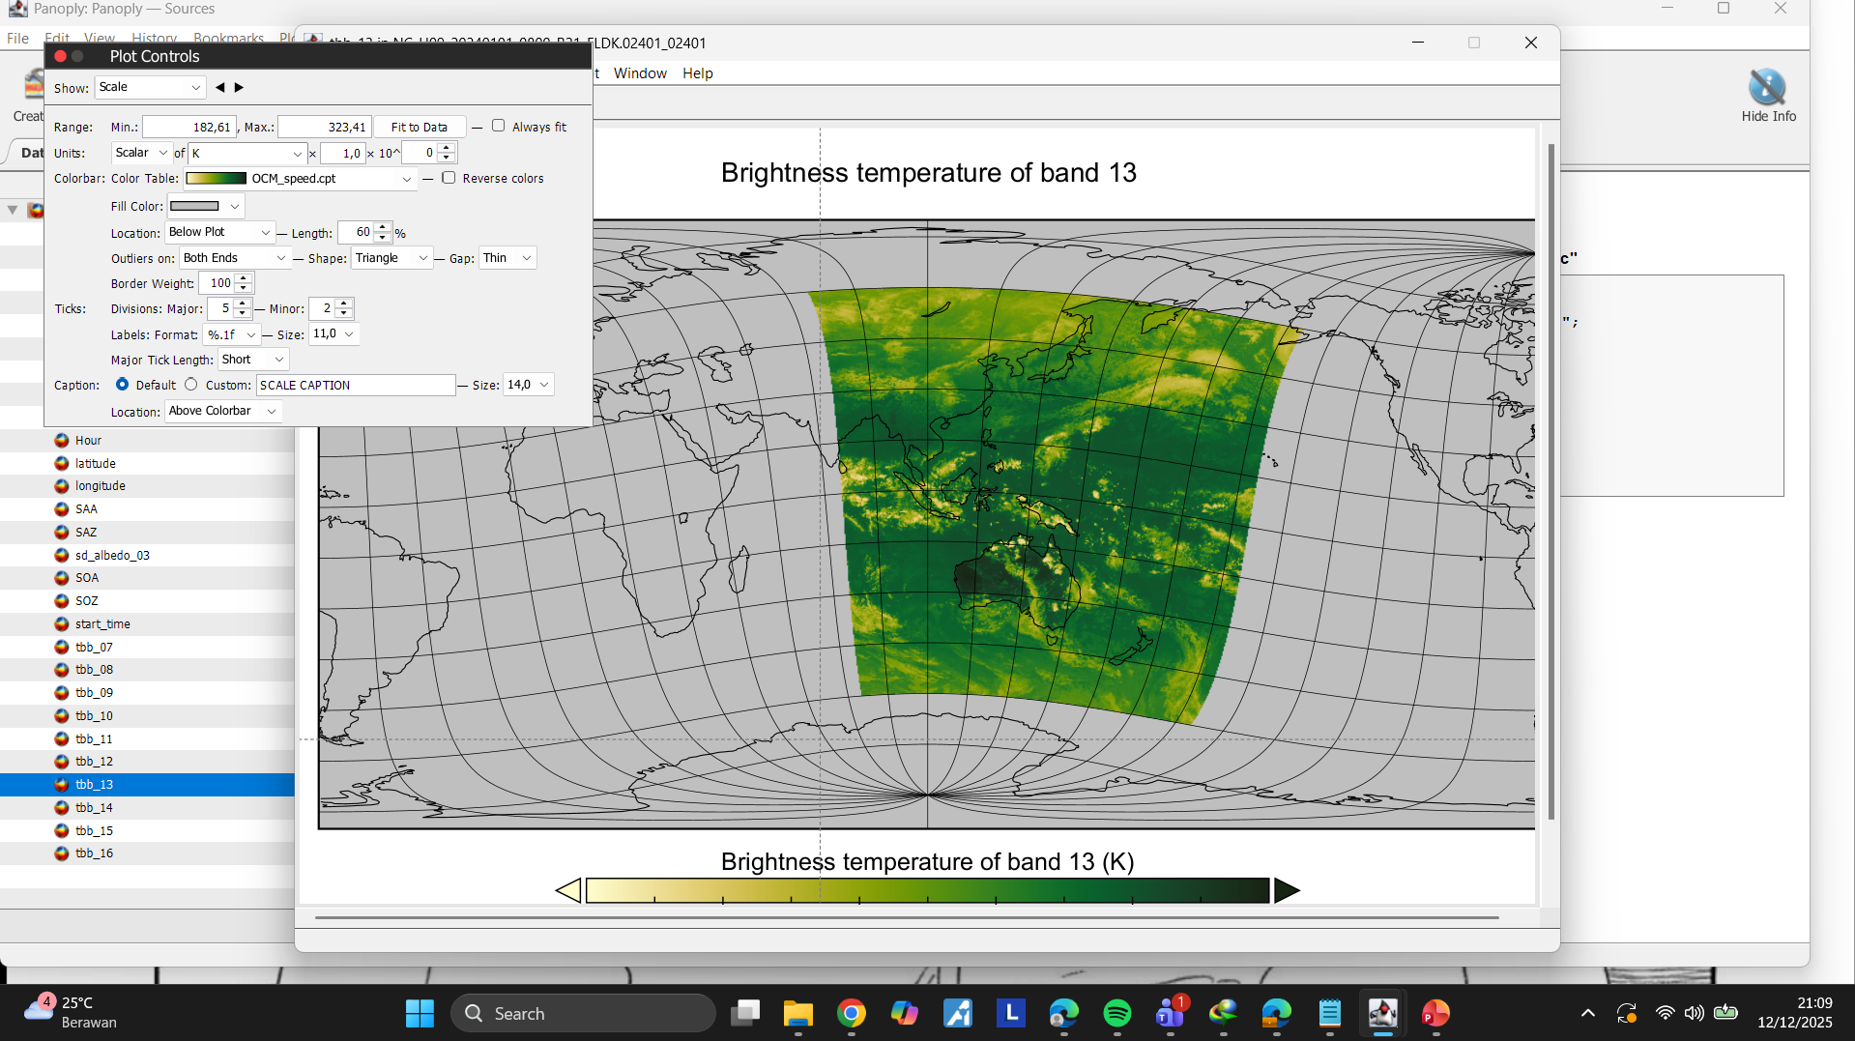
Scale

Slide 6
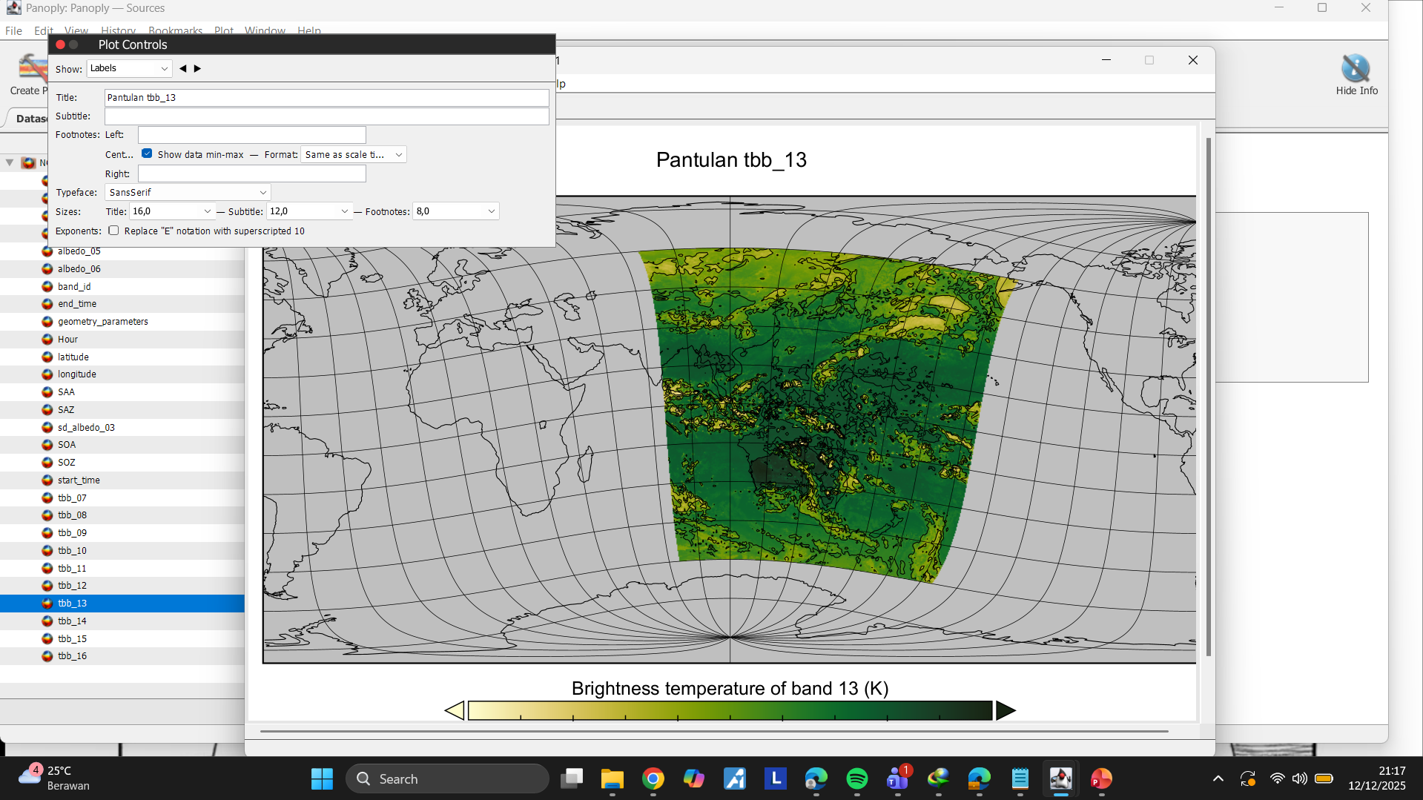
Labeling

Slide 7
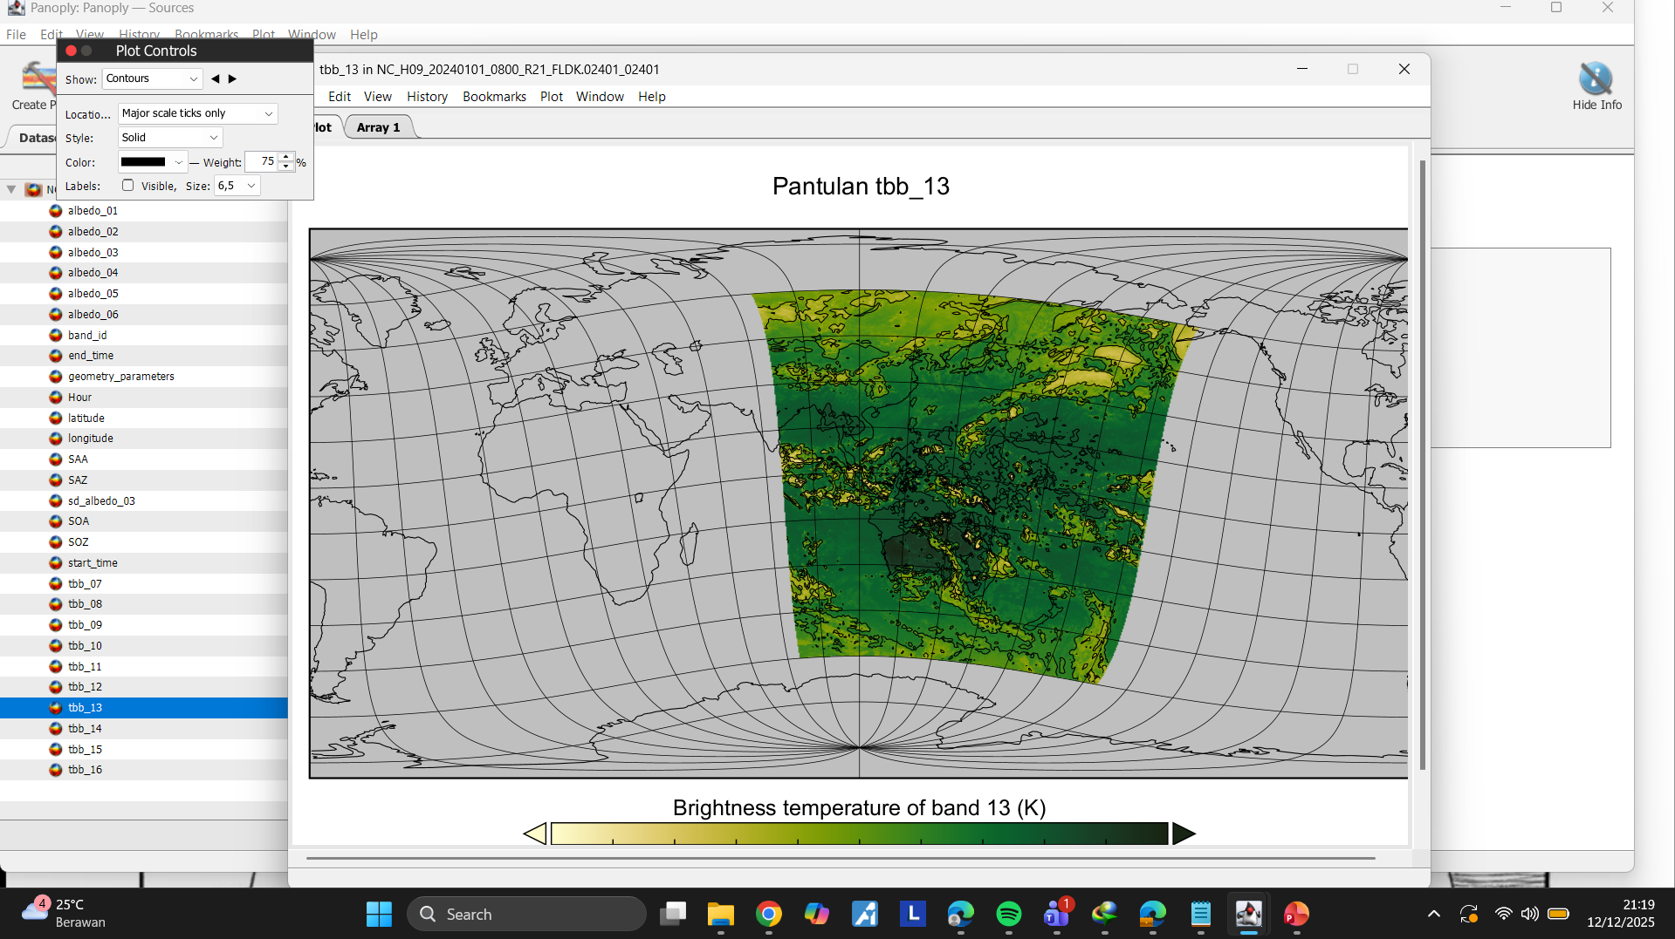
Contour

Slide 8
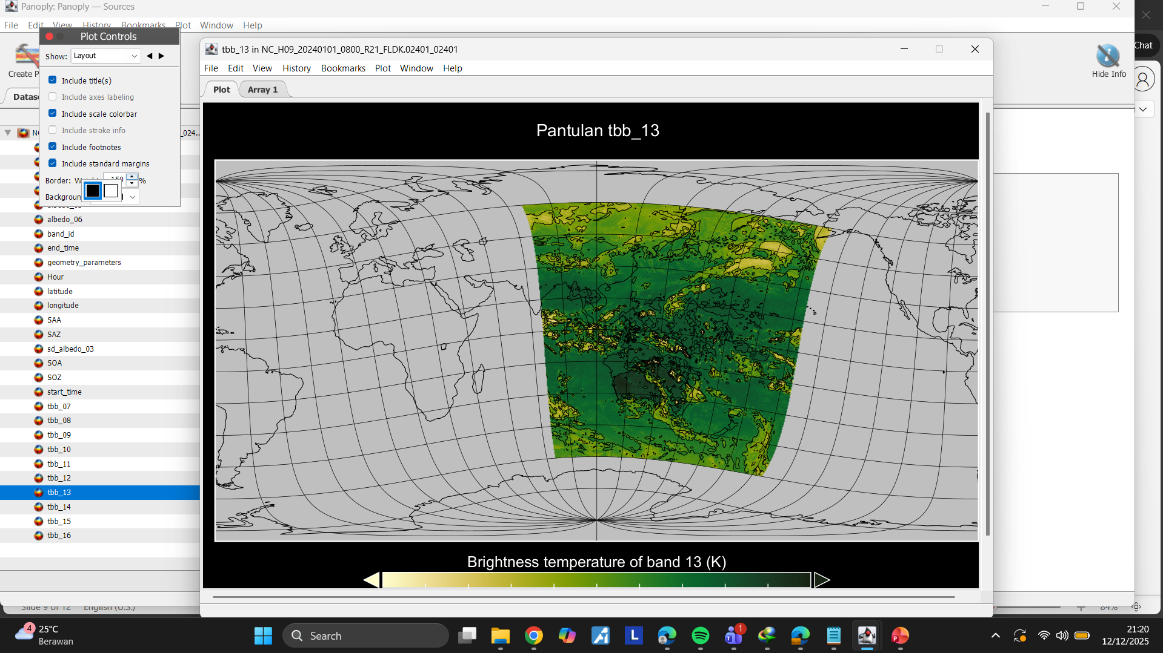
Layout

Slide 9
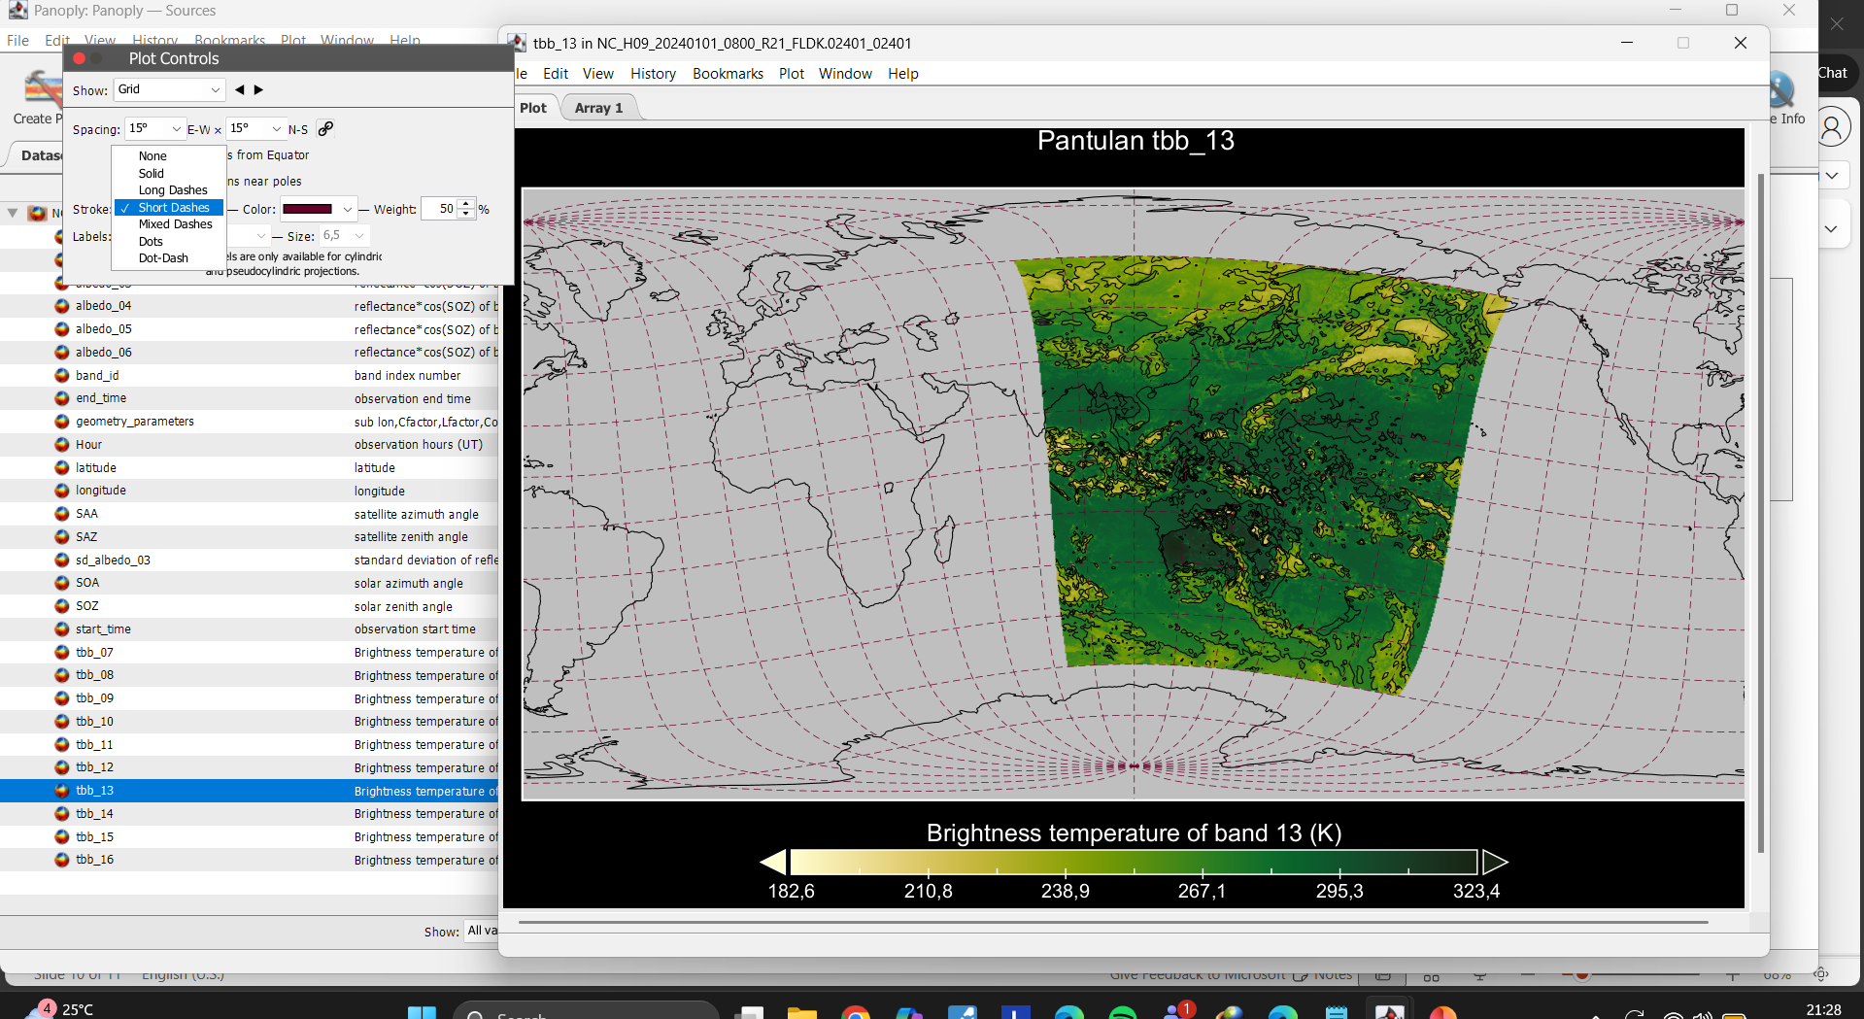
Grid

Slide 10
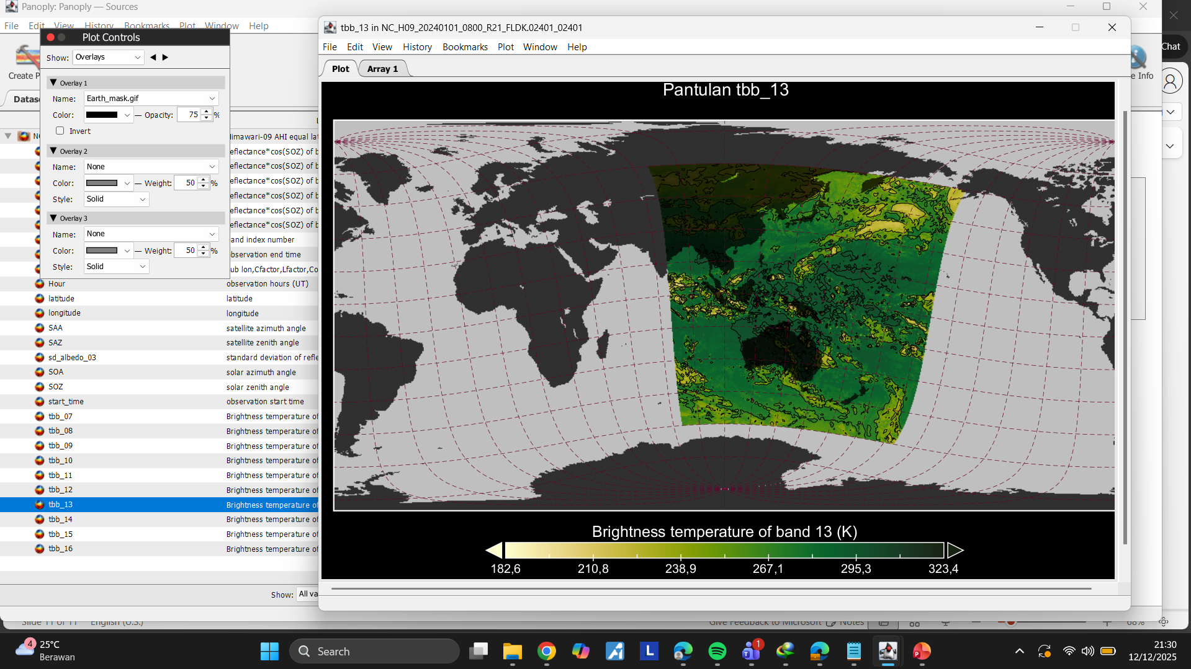
Overlays

